Slide 1
CSC 112: Computer Operating Systems Lecture XX Deleted
Department of Computer Science,
Hofstra University

Slide 2
Cache Quiz IV
Consider 8-bit address space; a direct mapped, write-back, write-allocate cache that can hold two blocks of 8 Bytes each. The cache is initially empty. The following sequence of memory operations are made, where each reference is a byte address of a 4-byte number (Only consider word aligned word addresses, i.e. locations 0, 4, 8, and so on. lw: load word; sw: store word) :
lw 0
sw 44
lw 52
lw 88
lw 0
sw 52
lw 68
lw 44
Work out the cache behavior after each operation.

Slide 3
Quiz IV Answer
Tag: 4 Index: 1 Offset: 3. The low-order 3 bits of an address specifies the byte address, and the next 1 bit is the index. I'll write addresses as a triple of tag:index:offset. We have:
lw 0 = 0000:0:000
Bytes 0-7 loaded into cache index 0.
sw 44= 0010:1:100
Bytes 40-47 loaded into cache index 1; bytes 44-47 modified; block marked "dirty".
lw 52 = 0011:0:100
Bytes 48-55 loaded into cache index 0; Clean miss (since replaced block was clean), previous block discarded
lw 88 = 0101:1:000
Bytes 88-95 loaded into cache index 1; Dirty miss (since replaced block was dirty); previous (dirty) contents written back to memory; block marked "clean“
lw 0 = 0000:0:000
Bytes 0-7 loaded into cache index 0. Clean miss; block marked “clean”
sw 52 = 0011:0:100
Bytes 48-55 loaded into cache index 0. Clean miss. bytes 52-55 modified; block marked "dirty".
lw 68 = 0010:0:100
Bytes 64-71 brought into cache index 0; Dirty miss; previous (dirty) contents written back to memory; block marked “clean”.
lw 44 = 0010:1:100
Bytes 40-47 loaded into cache index1; Clean miss; block marked "clean".

Slide 4
Page Replacement Policies
How to implement LRU
Software Perfect LRU: a data structure to track reference time of all pages
Hardware Perfect LRU: add a timestamp register to each page
Practical LRU: approximate implementation, find an old page, but not necessarily the oldest one;
Clock Algorithm (Second chance)
A use/reference bit for each page:
0 not used
1 used
A circular queue of all physical pages
A clock hand to select which page to evict:
0: evicted
1: set to 0 and move to next

Slide 5
Page Replacement Policies

Slide 6
Least Recently Used (LRU)
Replace page that hasn’t been used for the longest time
Programs have locality, so if something not used for a while, unlikely to be used in the near future.
Seems like LRU should be a good approximation to OPT.
How to implement LRU? Use a list!
On each use, remove page from list and place at head
LRU page is at tail
Problems with this scheme for paging?
List must be updated at every memory reference; List manipulation is expensive
In practice, people approximate LRU (more later)
Page 6
Page 7
Page 1
Page 2
Head
Tail (LRU)
Notes:
Need to know immediately when each page used so that can change position in list…

Slide 7
FIFO
Throw out oldest page.
Be fair – let every page live in memory for same amount of time.
Bad, because it tends to throw out heavily used pages instead of infrequently used pages
Second-chance algorithm avoids this problem by giving recently-used pages a second chance
Notes:
Maintain a list of pages presently in page frames
When a page is placed in a page frame in physical memory add it to the end of the list
When a page fault occurs and all slots in physical memory are full remove the first page in the list from memory and replace it with the new page.
Problem: if the page removed is heavily and continuously used it will then have to be reloaded almost immediately (as soon as it is next accessed)

Slide 8
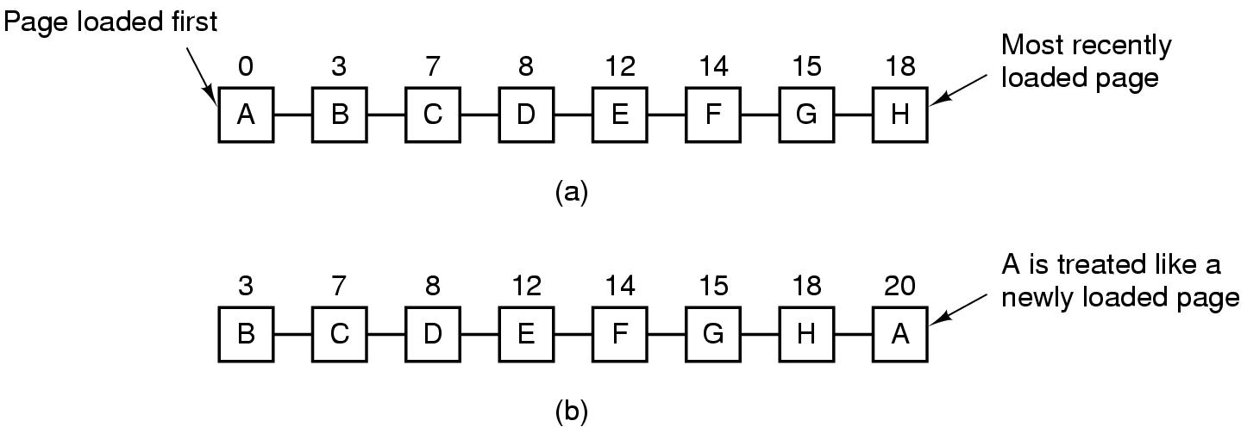
Second-Chance Algorithm
Give recently-used pages a second chance
If the oldest page has R=0, then choose it for replacement; if R=1, then move it to the end, and update its load time as through it’s a new arrival
(a) Pages sorted in FIFO order. (b) Page list if a page fault occurs at time 20 and A has its R bit set. The numbers above the pages are their load times.

Slide 9
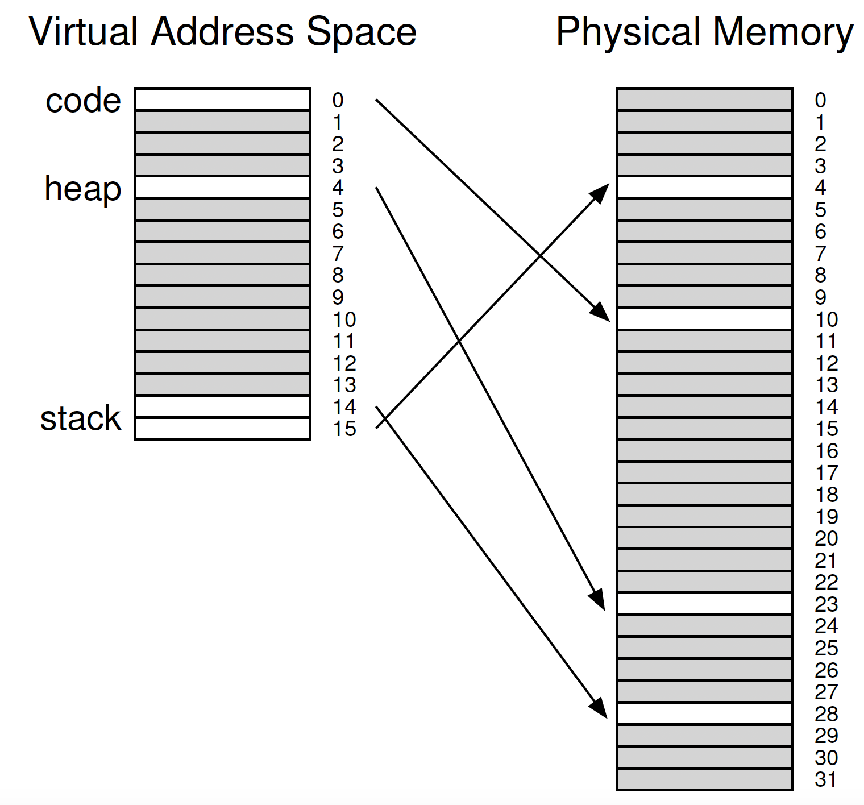
Paging+Segmentation
Hybrid Approach: Paging and Segments
Recall: Segmentation
Different registers for each segment
Instead of one single page table for one process, one page table for each logical segment
16KB address space
1KB page size

Slide 10
Paging+Segmentation
Base register to point to the physical address of the page table
Limit register to determine the size of the segment, i.e., how many valid pages the segment has
32-bit virtual address space with 4KB pages
12-bit for offset
3 segments: code, heap, stack
2-bit for segmentation
Problems: page table waste for sparsely-used heap
Problems: external fragmentation
Notes:
Track base (physical address) and bounds of the page table per segment

Slide 11
Exercise
Consider a cache size of 3 page frames, and following reference stream of virtual pages:
7 0 1 2 0 3 0 4 2 3 0 3 2 1 2 0 1 7 0 1
Run FIFO, OPT and LRU on this example.
Answer:
FIFO: http://cs.uttyler.edu/Faculty/Rainwater/COSC3355/Animations/fifopagereplacement.htm
OPT: http://cs.uttyler.edu/Faculty/Rainwater/COSC3355/Animations/optimalpagereplacement.htm
LRU: http://cs.uttyler.edu/Faculty/Rainwater/COSC3355/Animations/lrupagereplacement.htm

Slide 13
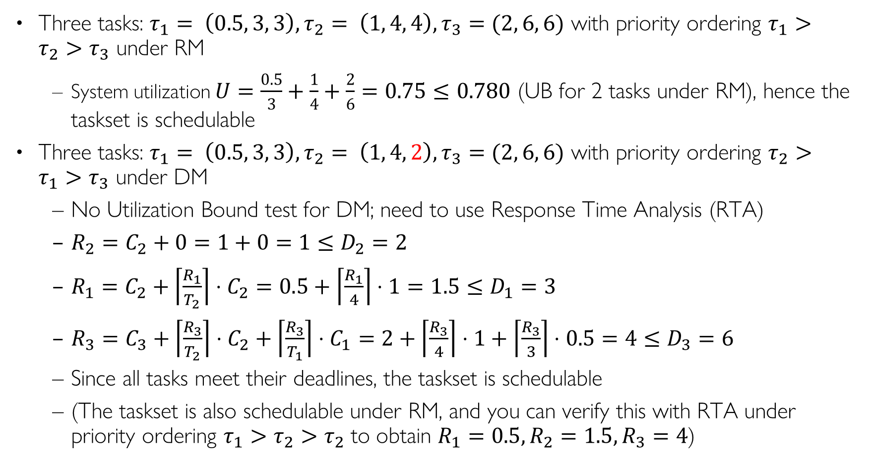
RM vs. DM Example Schedulability Analysis
Three tasks: $τ_{1}= \left(0.5, 3, 3\right), τ_{2}= \left(1, 4, 4\right), τ_{3}=(2, 6, 6)$ with priority ordering $τ_{1}>τ_{2}>τ_{3}$ under RM
System utilization $U=\frac{0.5}{3}+\frac{1}{4}+\frac{2}{6}=0.75≤0.780$ (UB for 2 tasks under RM), hence the taskset is schedulable
Three tasks: $τ_{1}= \left(0.5, 3, 3\right), τ_{2}= \left(1, 4, 2\right), τ_{3}=(2, 6, 6)$ with priority ordering $τ_{2}>τ_{1}>τ_{3}$ under DM
No Utilization Bound test for DM; need to use Response Time Analysis (RTA)
$R_{2}=C_{2}+0=1+0=1≤D_{2}=2$
$R_{1}=C_{2}+\left\lceil \frac{R_{1}}{T_{2}}\right\rceil ⋅C_{2}=0.5+\left\lceil \frac{R_{1}}{4}\right\rceil ⋅1=1.5≤D_{1}=3$
$R_{3}=C_{3}+\left\lceil \frac{R_{3}}{T_{2}}\right\rceil ⋅C_{2}+\left\lceil \frac{R_{3}}{T_{1}}\right\rceil ⋅C_{1}=2+\left\lceil \frac{R_{3}}{4}\right\rceil ⋅1+\left\lceil \frac{R_{3}}{3}\right\rceil ⋅0.5=4≤D_{3}=6$
Since all tasks meet their deadlines, the taskset is schedulable
(The taskset is also schedulable under RM, and you can verify this with RTA under priority ordering $τ_{1}>τ_{2}>τ_{2}$ to obtain $R_{1}=0.5, R_{2}=1.5, R_{3}=4$)
Notes:
0.5/3+1/4+2/6=
R3=2+ceil(R3/3)0.5+ceil(R3/4)1=4

Slide 14
Issues
None of these approaches is appropriate for all types of resources
Some processes (like updating a database) cannot be killed and rerun safely.
Some resources cannot be safely preempted (some of these like printers can be preempted if spooling is used).
Some processes cannot be rolled back.
How do you roll back shared variables that have been successively updated by multiple processes.
process rollback is expensive.
Successive checkpoints must save both image and state.
Multiple checkpoints need to be saved for a process.

Slide 15
Deadlock recovery
Abort all deadlocked processes:
most common solution implemented in OSs.
Rollback:
Back up each process periodically.
in case of deadlock roll back to the previous backup (checkpoint).
It is possible the deadlock may reoccur.
Usually the deadlock will not reoccur due to the nondeterministic nature of the execution of concurrent processes (there may be a different interleaving of instruction executions the next time).

Slide 16
Deadlock recovery: 2
Successively abort deadlocked processes.
Abort 1 deadlocked process at a time.
Then check if the deadlock still occurs
If it does abort the next process.
If it does not, continue execution of the remaining processes without aborting any more processes.
Successively take away resources from blocked processes
Take away 1 deadlocked resource in 1 process.
Roll back that process to the point where the preempted resource was allocated.
Check if deadlock still occurs
If it does, take away resource from the next process.
If it does not, continue execution of the remaining processes without preempting any more resources.

Slide 17
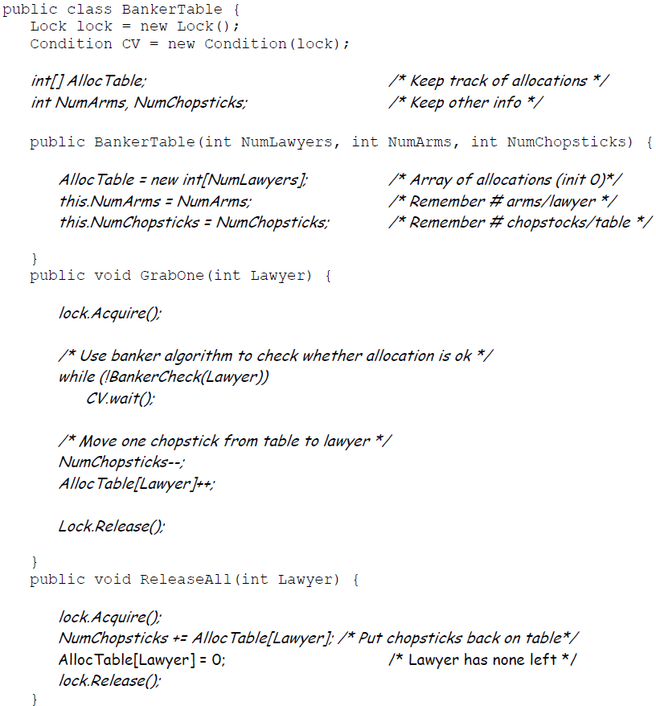
Multi-Armed Lawyers Solution w/ Monitors
GrabOne() allows a lawyer to grab one chopstick. It puts a lawyer to sleep if he cannot be granted a chopstick without potentially deadlocking the system.
ReleaseAll() allows a lawyer to release all chopsticks that he is holding. It wakes up any other lawyers that can proceed.
BankerCheck() method takes a Lawyer number, checks resources, and returns true if a given lawyer can be granted one new chopstick.
Notes:
Assume Mesa-style monitor, hence while loop is used in GrabOne().

Slide 18
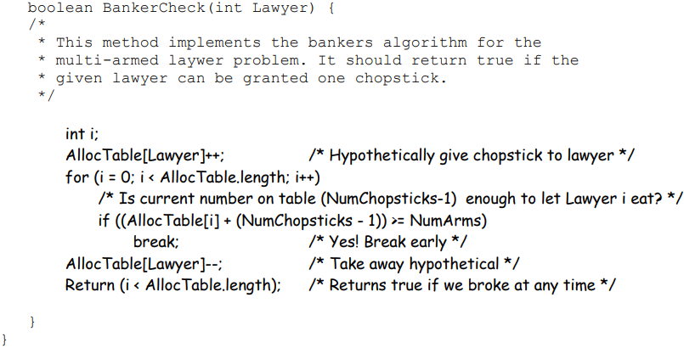
BankerCheck()
State is safe if when a lawyer tries to take a chopstick, either
It is the last chopstick, but someone (lawyer i) will have NumArms chopsticks afterwards
Or it is the 2nd to last chopstick, but someone (lawyer i) will have NumArms-1 chopsticks afterwards
Or it is the 3rd to last chopstick, but someone (lawyer i) will have NumArms-2 chopsticks afterwards …
And so on…
Q: Why didn’t we check for the case of NumChopsticks == 0?
A: In this case, (NumChopsticks-1) == -1, hence the if statement would always fail – exactly what we would want to do when NumChopsticks == 0.
In its general form, the Banker’s algorithm makes multiple passes through the set of resource takers for deadlock detection. But this particular application allows the BankerCheck() method to take a single pass though the Lawyers’ allocations. This is because every resource taker has identical properties: every Lawyer has the same NumArms (maximum allocation). As a result, if we can find a single Lawyer that can finish, given the remaining resources, we know that all Lawyers can finish. Reason: once that Lawyer finishes and returns their resources we know that there will be at least NumArms chopsticks on the table – hence everyone else can potentially finish. Thus, we don’t have to go through the exercise of returning resources and reexamining the remaining Lawyers (as in the general Banker’s algorithm).
Notes:
(We don’t have to check for the case in which NumChopsticks == 0, since this would mean that (NumChopsticks-1) == -1, then the if statement would always fail – exactly what we would want to do when NumChopsticks == 0.)

Slide 19
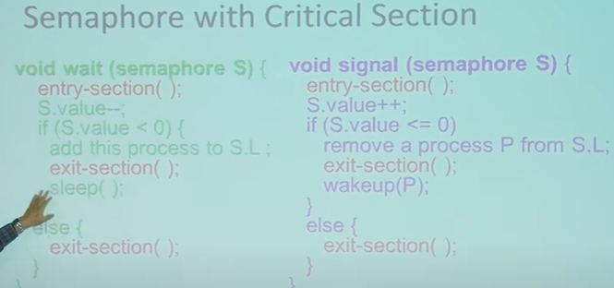
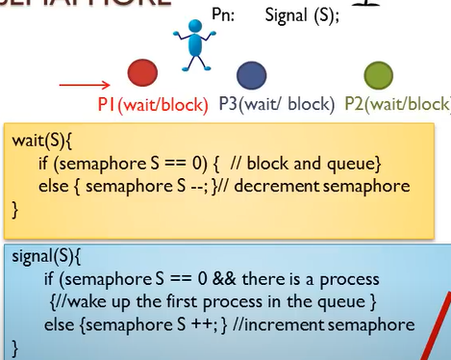

Slide 20
Scheduling Fairness
What about fairness?
Strict fixed-priority scheduling between queues is unfair (run highest, then next, etc):
long running jobs may never get CPU
Urban legend: In Multics, shut down machine, found 10-year-old job ⇒ Ok, probably not…
Must give long-running jobs a fraction of the CPU even when there are shorter jobs to run
Tradeoff: fairness gained by hurting average response time!
How to implement fairness?
Could give each queue some fraction of the CPU
What if one long-running job and 100 short-running ones?
Like express lanes in a supermarket—sometimes express lanes get so long, get better service by going into one of the other lines
Could increase priority of jobs that don’t get service
What is done in some variants of UNIX
This is ad hoc—what rate should you increase priorities?
And, as system gets overloaded, no job gets CPU time, so everyone increases in priority⇒Interactive jobs suffer

Slide 21
Multi-Core Scheduling
Algorithmically, not a huge difference from single-core scheduling
Implementation-wise, helpful to have per-core scheduling data structures
Cache coherence
Affinity scheduling: once a thread is scheduled on a CPU, OS tries to reschedule it on the same CPU
Cache reuse

Slide 22
Recall: Spinlock
Spinlock doesn’t put the calling thread to sleep—it busy waits in a while() loop
For multiprocessor cache coherence: every test&set() is a write, which makes the shared lock data structure ping-pong around in multiple caches on different cores, thus causing lots of memory BW
typedef struct __lock_t{
int flag;
} lock_t;
int TestAndSet(int *old_ptr, int new){
int old = *old_ptr;
*old_ptr = new;
return old;
}
void lock(lock_t *lock){
while (TestAndSet(&lock->flag, 1) == 1)
; // spin-wait
}
void unlock(lock_t *lock){
lock->flag = 0;
}
Notes:
int value = 0; // Free
Acquire() { while (test&set(value)) {}; // spin while busy }
Release() { value = 0; // atomic store } When might this be preferable?

Slide 23
Gang Scheduling and Parallel Applications
When multiple threads work together on a multi-core system, try to schedule them together
Makes spin-waiting more efficient (inefficient to spin-wait for a thread that’s not actively running/suspended)
Alternative: OS informs a parallel program how many processors its threads are scheduled on (Scheduler Activations)
Application adapts to number of cores that it has scheduled
“Space sharing” with other parallel programs can be more efficient, because parallel speedup is often sublinear with the number of cores

Slide 24
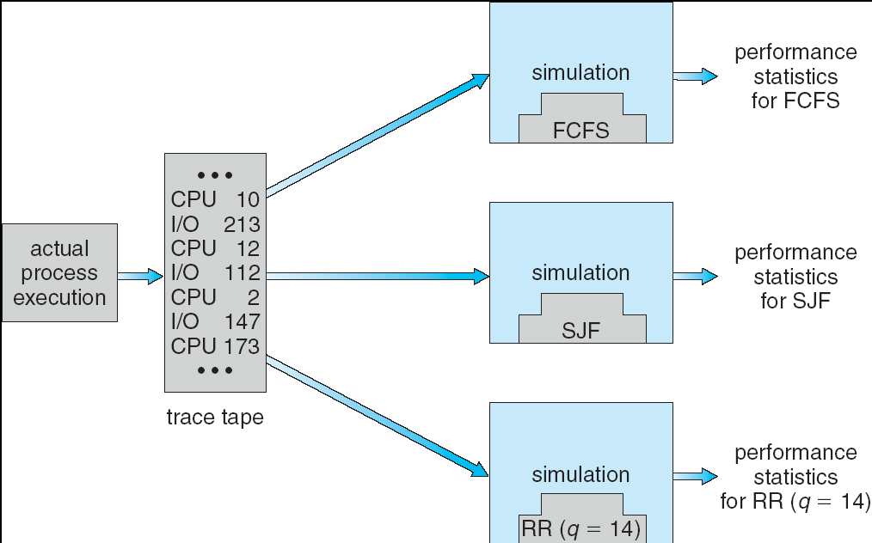
How to Evaluate a Scheduling algorithm?
Deterministic modeling
takes a predetermined workload and compute the performance of each algorithm for that workload
Queueing models
Mathematical approach for handling stochastic workloads
Implementation/Simulation:
Build system which allows actual algorithms to be run against actual data
Most flexible/general

Slide 25
How to Handle Simultaneous Mix of Diff Types of Apps?
Consider mix of interactive and high throughput apps:
How to best schedule them?
How to recognize one from the other?
Do you trust app to say that it is “interactive”?
Should you schedule the set of apps identically on servers, workstations, pads, and cellphones?
For instance, is Burst Time (observed) useful to decide which application gets CPU time?
Short Bursts ⇒ Interactivity ⇒ High Priority?
Assumptions encoded into many schedulers:
Apps that sleep a lot and have short bursts must be interactive apps – they should get high priority
Apps that compute a lot should get low(er?) priority, since they won’t notice intermittent bursts from interactive apps
Hard to characterize apps:
What about apps that sleep for a long time, but then compute for a long time?
Or, what about apps that must run under all circumstances (say periodically)

Slide 26
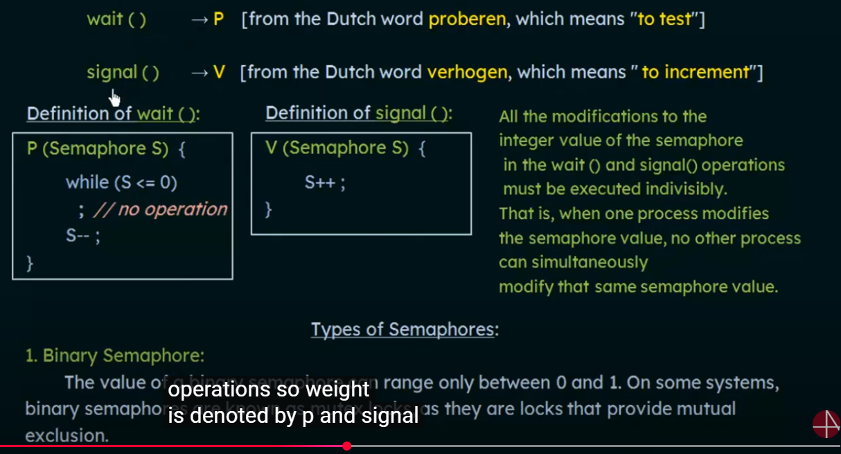

Slide 27
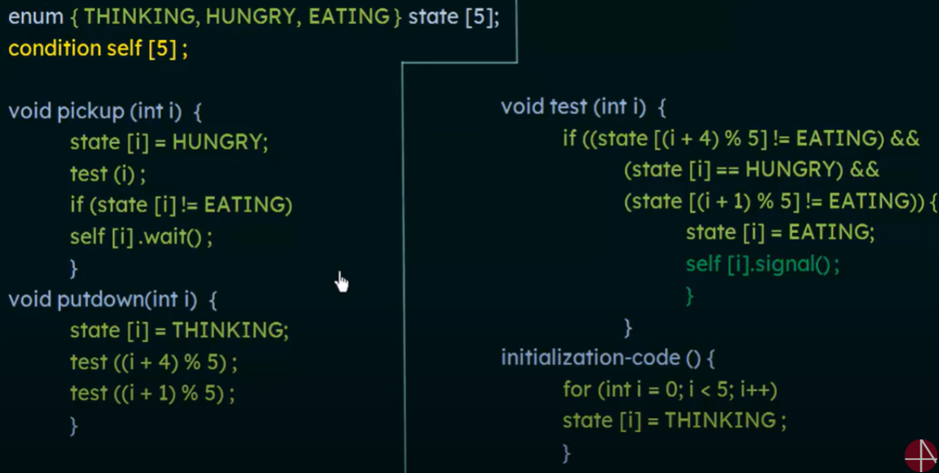
#define N 5 // Number of philosophers and forks
enum { THINKING, HUNGRY, EATING } state[N];
mutex_t mutex = 1; // Monitor's mutex
condition self[N]; // Condition variable for each philosopher
void philosopher(int i) {
while (true) {
think();
pickup(i);
eat();
putdown(i);
}
}
void pickup(int i) {
mutex_lock(&mutex);
state[i] = HUNGRY;
test(i);
while (state[i] != EATING)
cond_wait(&self[i], &mutex); //Block if forks weren't acquired
mutex_unlock(&mutex);
}
void putdown(int i) {
mutex_lock(&mutex);
state[i] = THINKING;
test((i + 4) % N); // Test left neighbor
test((i + 1) % N); // Test right neighbor
mutex_unlock(&mutex);
}
void test(int i) {
if (state[i] == HUNGRY &&
state[(i + 4) % N] != EATING &&
state[(i + 1) % N] != EATING) {
state[i] = EATING;
cond_signal(&self[i]);
}
}

Slide 28

Solution to P/C Problem
Sem_t fullSlots, emptySlots, mutex;
sem_init(&fullSlots, 0, 0); //Initially, no data item
sem_init(&emptySlots, 0, bufSize)://Initially, all slots empty
sem_init(&mutex, 0, 1):
Producer(item) { emptySlots.wait_sem();//Wait until empty slots available mutex.wait(); enqueue(item); mutex.signal(); fullSlots.signal(); }
Consumer() { fullSlots.wait( //Wait until full slots available mutex.wait(); item = dequeue(); mutex.signal(); emptySlots.signal(); return item; }
mutex protects integrity of the queue within critical sections
fullSlots signals 1 more data item
emptySlots
signals 1 more empty slot
emptySlots==0: Producer waits; fullSlots ==0: Consumer waits;
fullSlots>0 && emptySlots>0: Producer and Consumer can enqueue/dequeue items concurrently (within critical section protected by mutex)
28
Notes:
//Tell consumer there is
semaphore emptySlots = bufSize
semaphore mutex = 1;
semaphore fullSlots = 0; //1 more data item

Slide 29
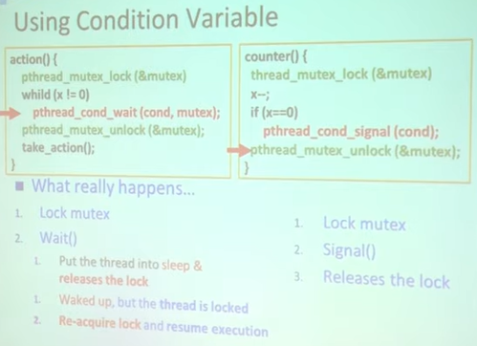
P/C Problem with Condition Variable
pthread_mutex_t mutex=HREAD_MUTEX_INITIALIZER;
pthread_cond_t producer_CV= PTHREAD_COND_INITIALIZER;
pthread_cond_t consumer_CV = PTHREAD_COND_INITIALIZER;
Producer(item) {
acquire(&buf_lock);
while (buffer full) { cond_wait(&producer_CV, &buf_lock); }
enqueue(item);
cond_signal(&consumer_CV); release(&buf_lock);
}
Thread goes to sleep during waiting, similar to semaphores
Consumer() {
acquire(buf_lock);
while (buffer empty) { cond_wait(&consumer_CV, &buf_lock); }
item = dequeue();
cond_signal(&producer_CV);
release(buf_lock);
return item
}
Notes:
lock buf_lock = <initially unlocked>
condition producer_CV = <initially empty waiting queue>
condition consumer_CV = <initially empty waiting queue>

Slide 30
Incorrect: CV with Flag & Lock
//Child
bool child_done = false; //Shared state
void thr_exit(){
pthread_mutex_lock(&m);
child_done = true; //Set flag
pthread_cond_signal(&c); //Signal parent
pthread_mutex_unlock(&m);
}
//Parent
void thr_join(){
pthread_mutex_lock(&m);
if(!child_done){ //Check flag
pthread_cond_wait(&c, &m);//Wait only if needed
}
pthread_mutex_unlock(&m);
}
Add a Boolean flag child_done:
The child_done flag ensures that even if pthread_cond_signal occurs before pthread_cond_wait, the parent will not block indefinitely because it will detect that child_done is already set.
Spurious wakeup problem:
The program assumes that once the parent thread is awakened, the condition child_done is guaranteed to be true. But it is possible for child_done to be false.
The parent thread may be awakened by the system without any signal from the child thread (i.e., pthread_cond_signal has not been called), since system-level events such as interrupts, signals, or other system-specific mechanisms may cause a thread to wake up prematurely. This is called spurious wakeups.
Notes:
Spurious wakeups usually happen because in between the time when the condition variable was signaled and when the awakened thread was finally able to run, another thread ran first and changed the condition again. In general, if multiple threads are awakened, the first one to run will find the condition satisfied, but the others may find the condition unsatisfied. In this way, there is a race condition between all the awakened threads. The first thread to run will win the race and find the condition satisfied, while the other threads will lose the race, and experience a spurious wakeup’
Example Scenario
The parent thread calls thr_join() and enters pthread_cond_wait.
A spurious wakeup occurs, causing pthread_cond_wait to return prematurely.
Since the condition (child_done) is only checked once with an if, the parent thread assumes it can proceed, even though the child has not yet called thr_exit() or set child_done = true.
The use of a loop around pthread_cond_wait ensures correctness in case of spurious wakeups.

Slide 31
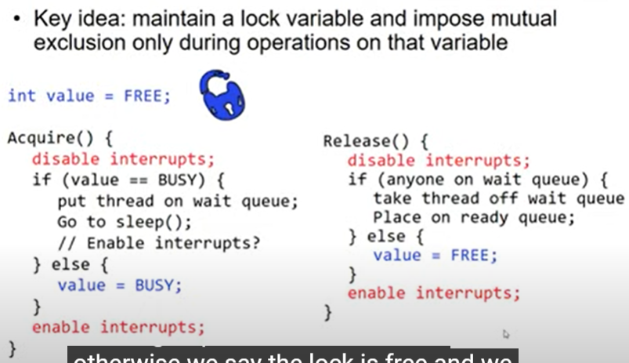

Slide 32
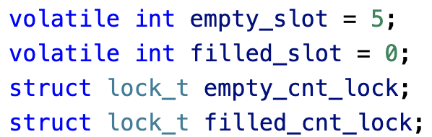
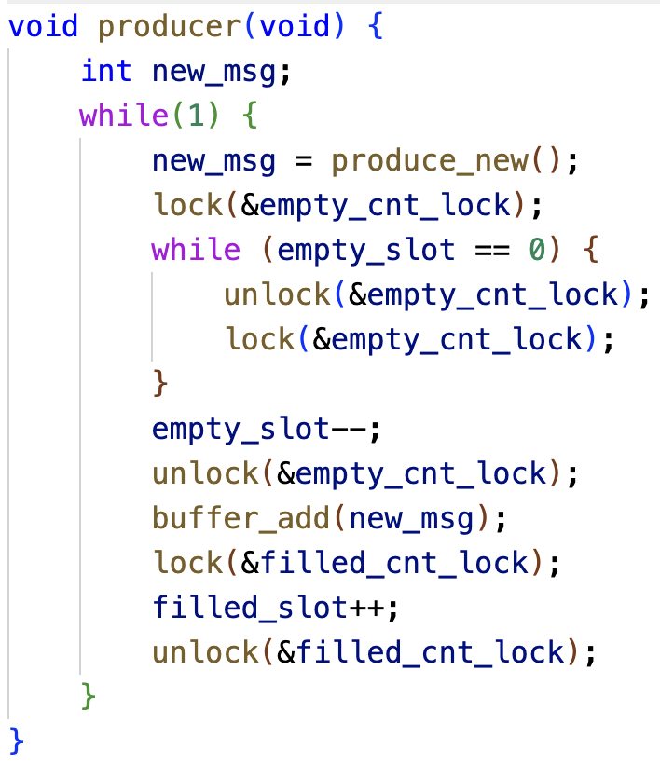
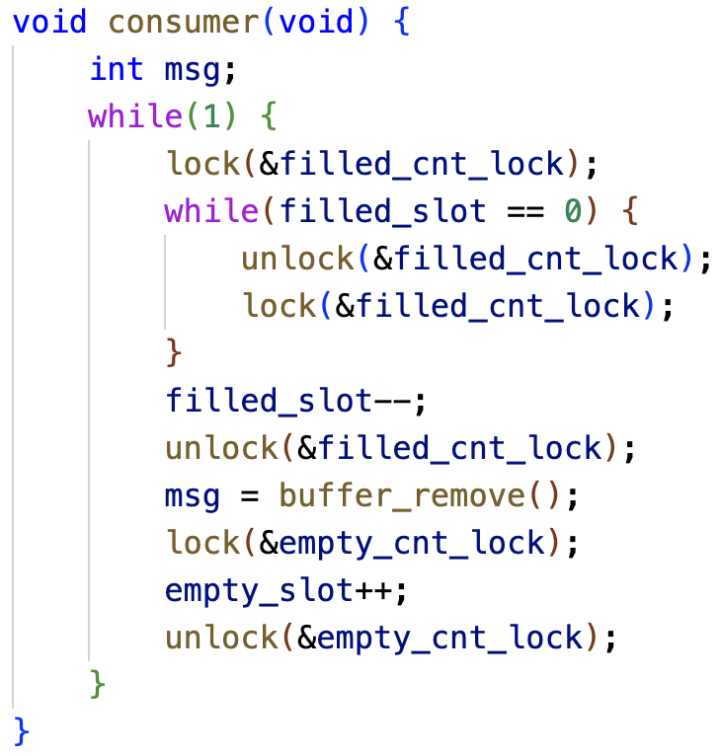
P/C Problems With Only Locks
Busy looping

Slide 33
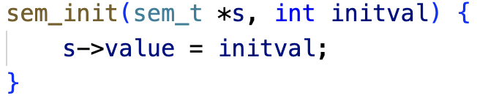
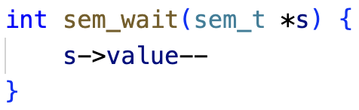
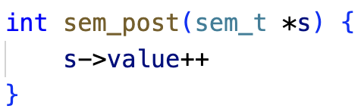
Semaphore Operations
Initialization
Wait or test
Decrements sem value by 1. Waits if value of sem is <0
Signal or post:
Increments sem value by 1. Then wake a single waiter if exists
;
;

Slide 34
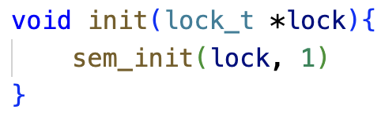
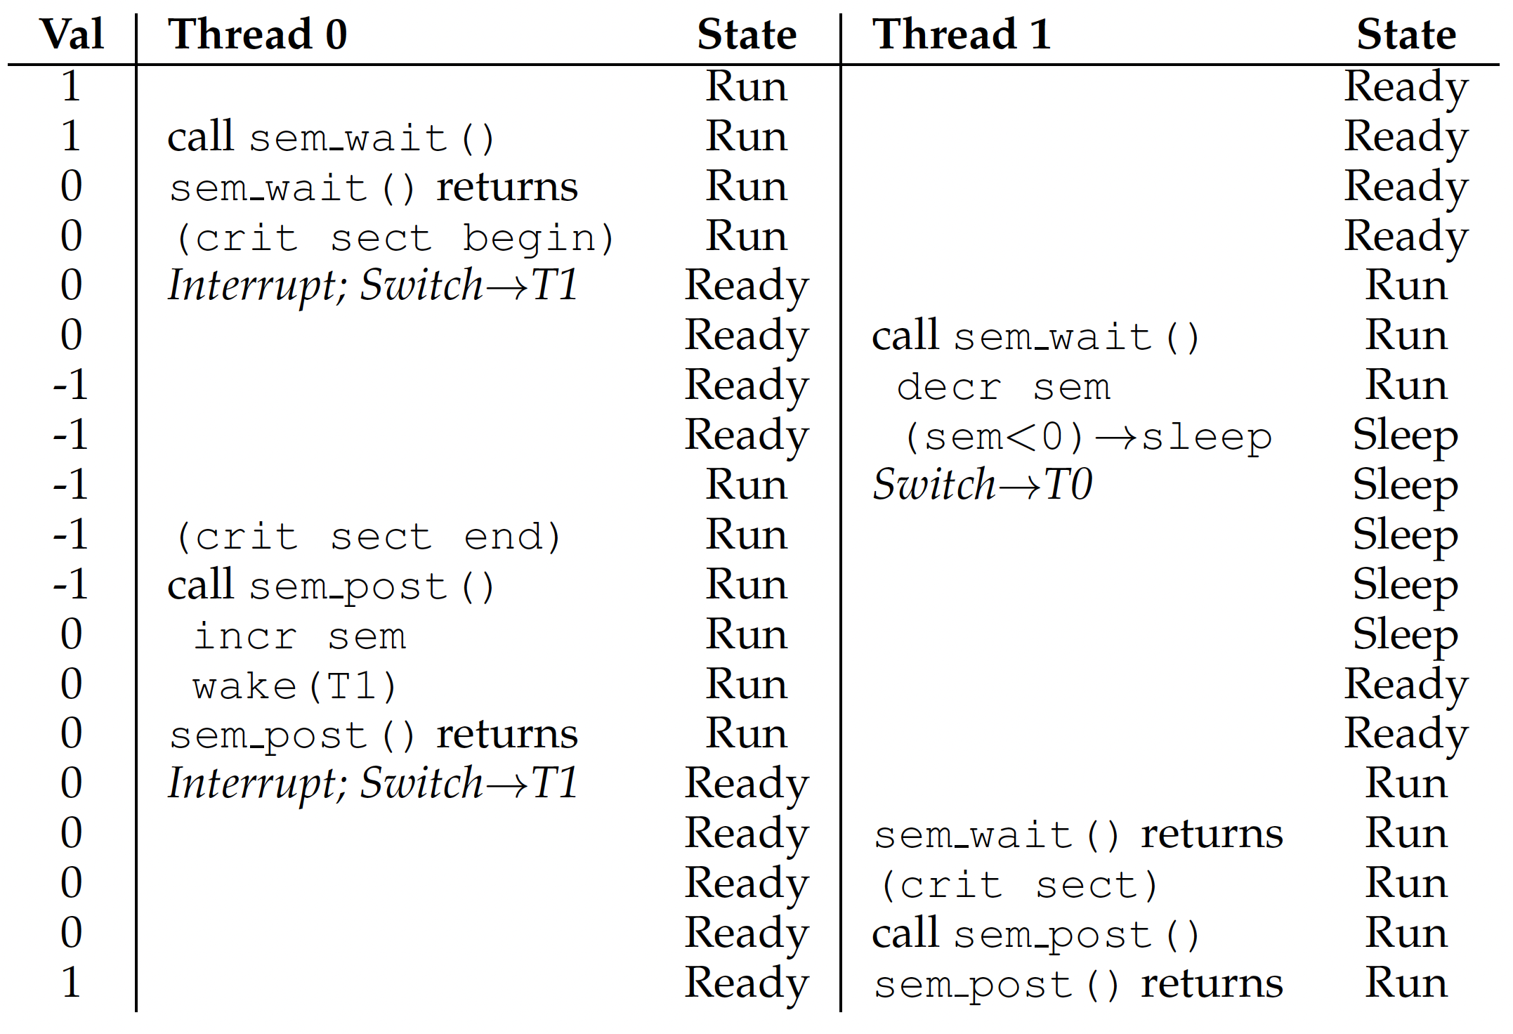
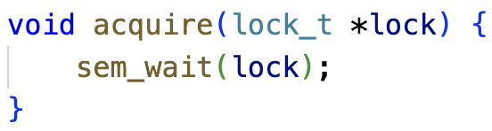
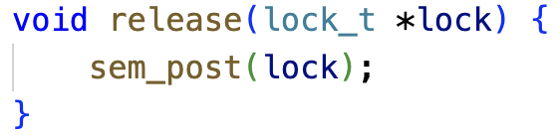
Binary Semaphore
Possible execution trace of two threads using a binary semaphore
Binary Semaphore is a mutex lock

Slide 35
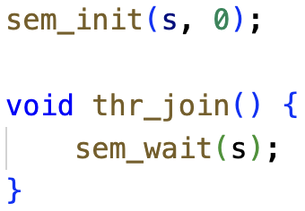
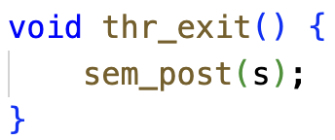
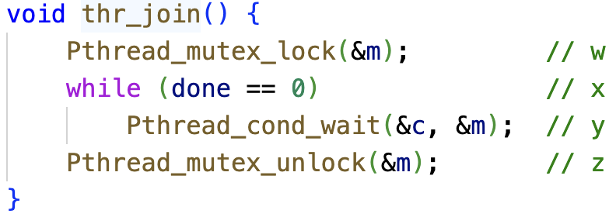
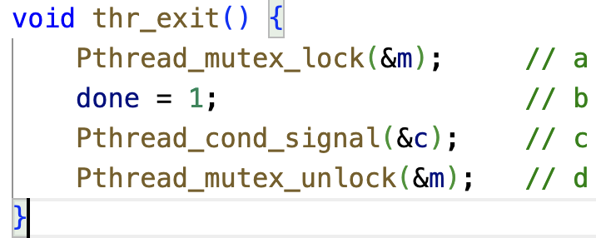
Semaphore for Ordering
Parent call thr_join() and waits for child to complete by calling thr_exit():
Equivalent implementation using a Condition variable (discussed later):

Slide 36
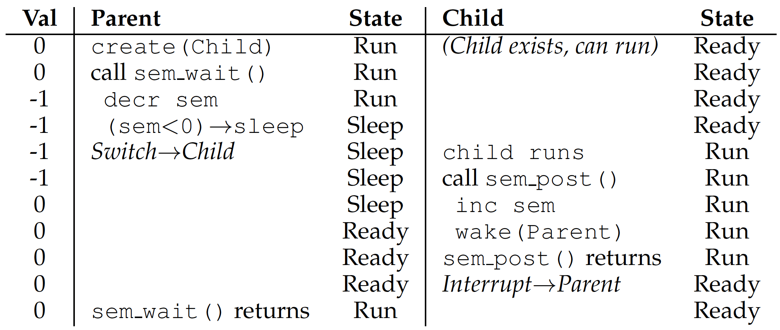
Semaphore for Ordering
Sem=-1 here
Case 1: parent runs first
Sem=-1
Sem=0

Slide 37
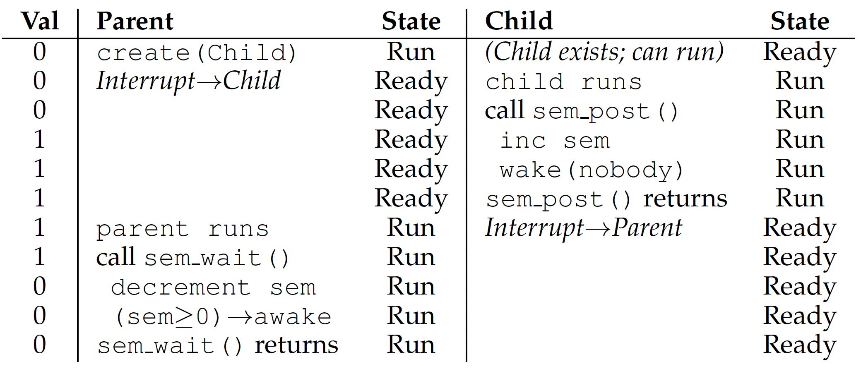
Semaphore for Ordering
Case 2: child runs first
Sem=1
Sem=0

Slide 38
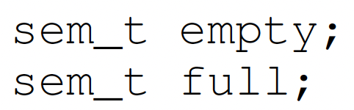
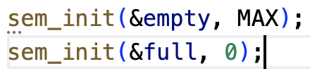
Semaphore for P/C
Shared data:
Initialization:
producer
consumer

Slide 39
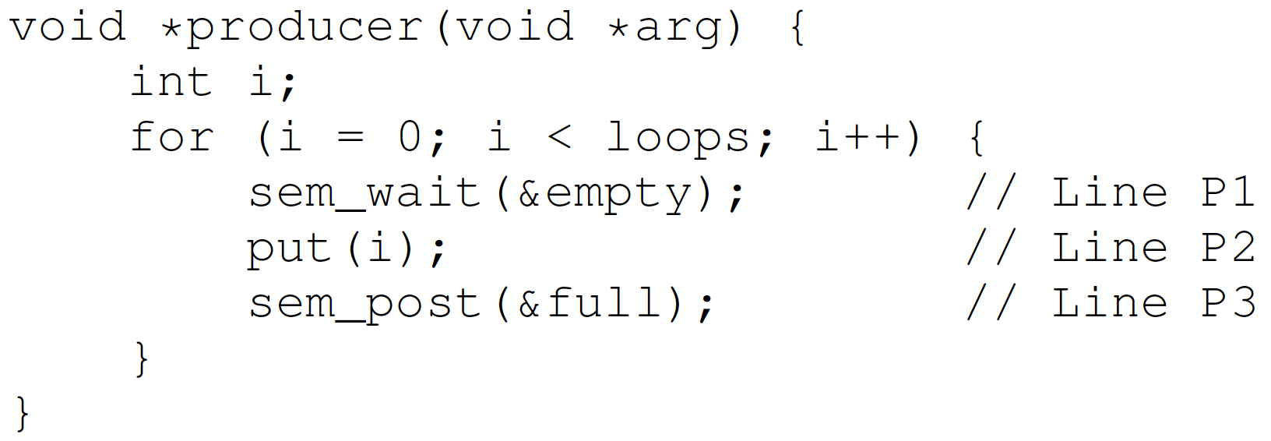
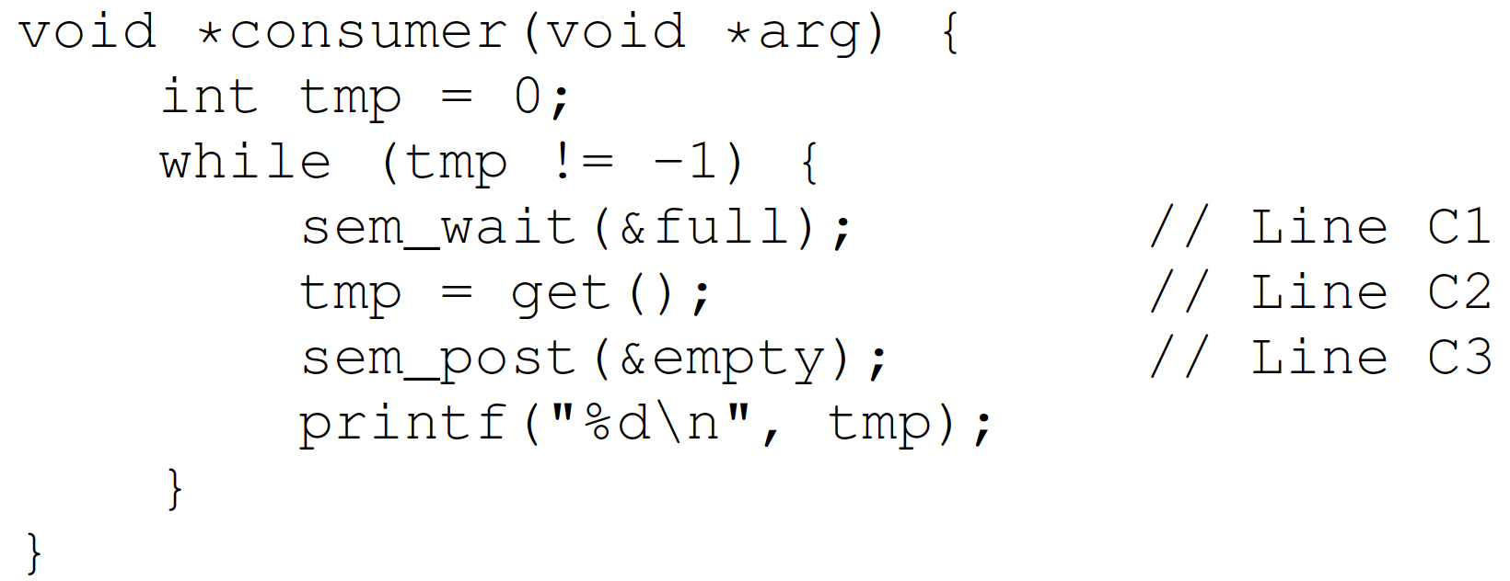
Semaphore for P/C
MAX=1

Slide 40
Semaphore for P/C
MAX > 1
Race condition

Slide 41
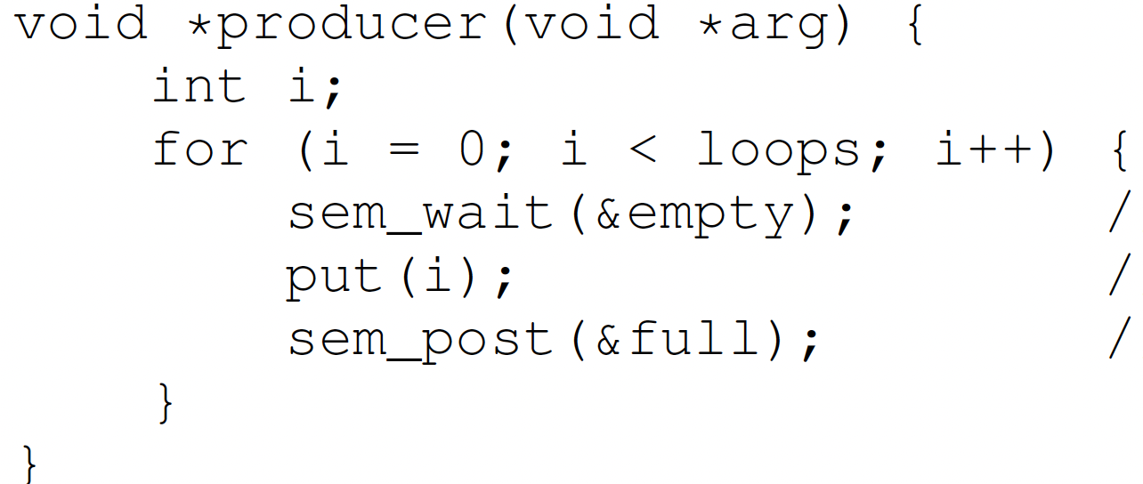
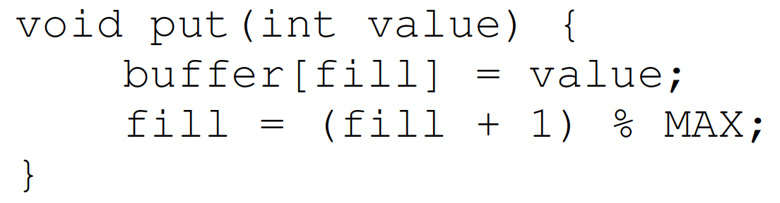
Semaphore for P/C
2 producers
Empty = 9
MAX=10
Producer 1
Producer 2

Slide 42
Semaphore for P/C
2 producers
Empty = 8
Producer 1
Producer 2
Interrupted
When Producer 2 thread preempts/interrupts Producer 1 thread just after it the line buffer[fill]=value, there is a race condition on the global variable fill, so fill is incremented only by 1 instead of by 2.

Slide 43
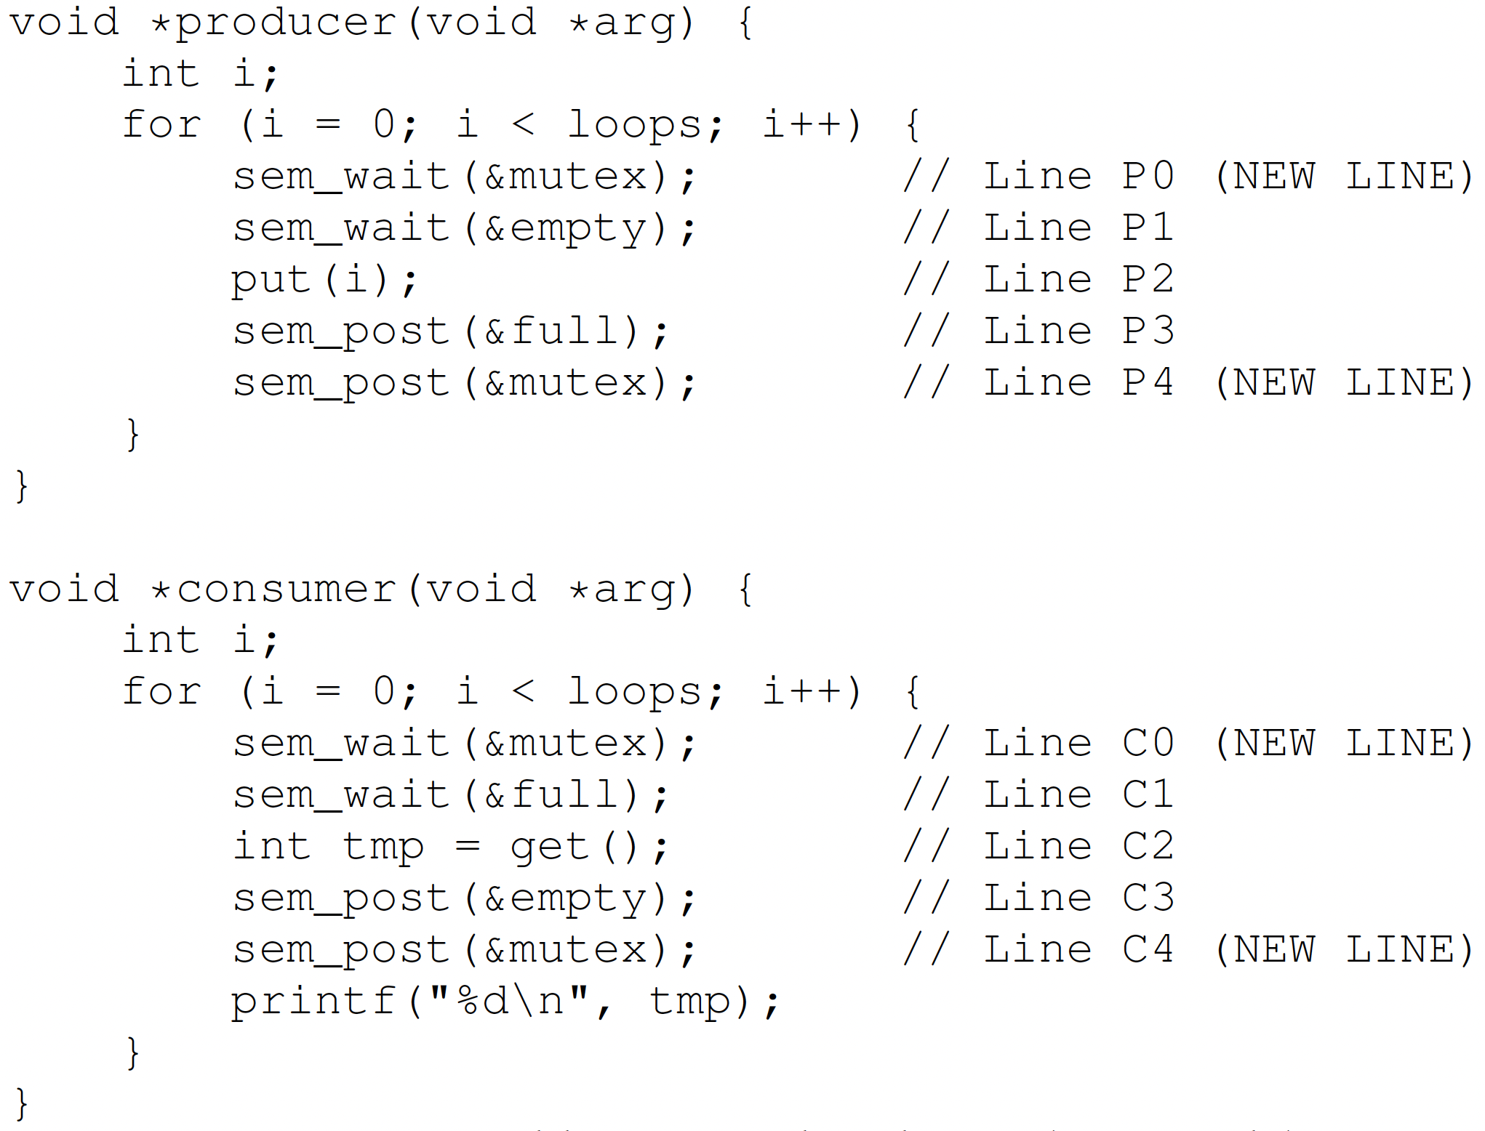
Semaphore for P/C – Mutex
Solution: add a mutex lock

Slide 44
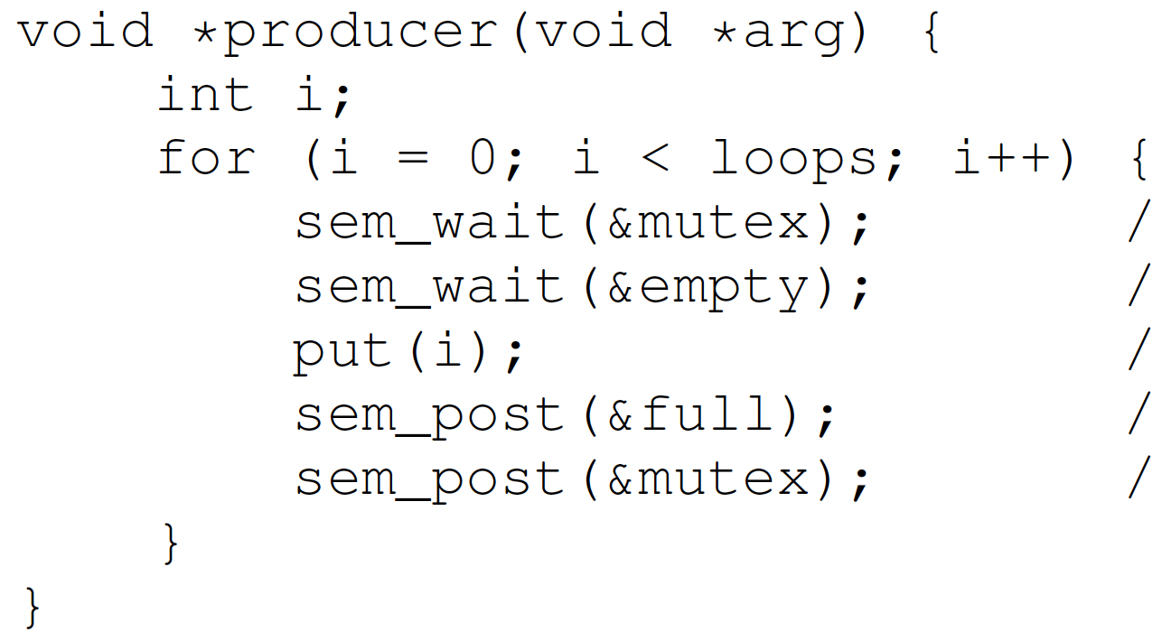
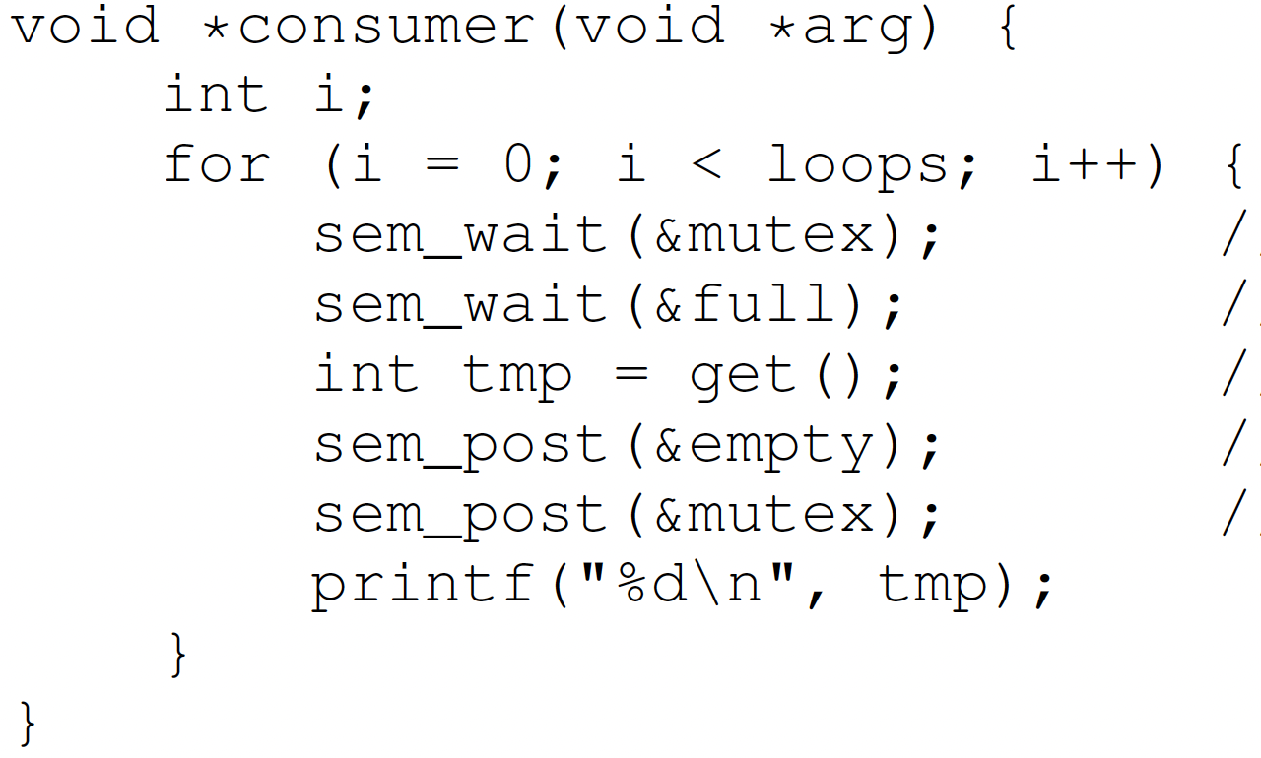
Semaphore for P/C – Mutex
mutex = 1
full = 0
empty = 10

Slide 45
Semaphore for P/C – Mutex
mutex = 0
full = 0
empty = 10
Ready
Wait for lock
Running
Hold lock
Wait for full
Deadlock occurred!

Slide 46
Semaphore for P/C – Mutex
mutex = 0
full = 0
empty = 10
Running
Wait for lock
Block
Hold lock
Wait for full

Slide 47
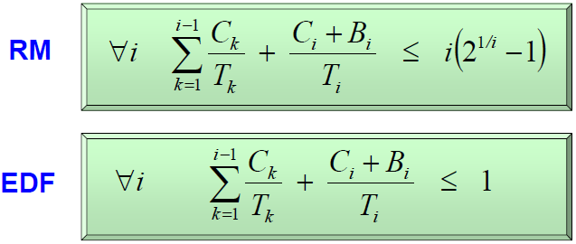
Utilization Bound w/ Blocking Time
Compute the maximum blocking time B_{i} for each task Tau_{i}
Inflate C_{i} by B_{i}
Notes:
For RM
Non Preemptive Protocol (NPP)
Highest Locker Priority (HLP)
Priority Inheritance (PIP)
Priority Ceiling (PCP)
Under EDF
Non Preemptive Protocol (NPP)
Dynamic Priority Inheritance (D-PIP)
Dynamic Priority Ceiling (D-PCP)
Stack Resource Policy (SRP)
We did not discuss D-PIP, D-PCP, SRP in class.

Slide 48
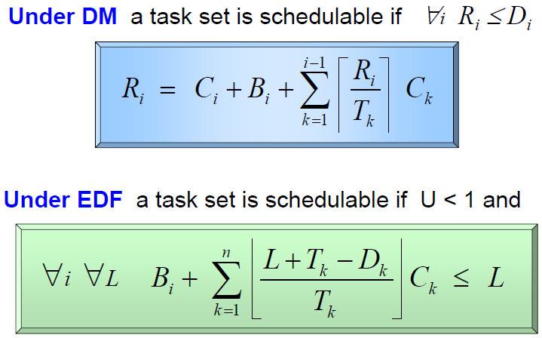
Exact Schedulability Analysis
RM or DM: Response Time Analysis (RTA)
EDF: Processor Demand Analysis

Slide 49
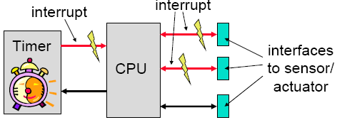
Event-Triggered (ET) Systems
Task release is triggered by external interrupts or events
Notes:
dynamic and adaptive: there are possible problems with respect to timing, the use of shared resources and buffer over-or underflow
guarantees can be given either off-line (if bounds on the behavior of the environment are known) or during run-time

Slide 50
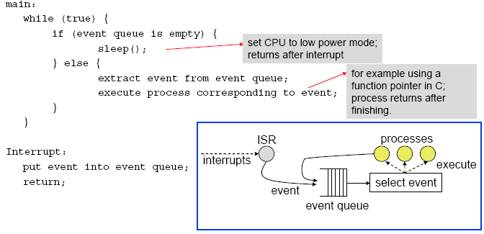
Non-Preemptive ET Scheduling Example
Notes:
Principle:
To each event, there is associated a corresponding process that will be executed.
Events are emitted by (a) external interrupts and (b) by processes themselves.
Events are collected in a queue; depending on the queuing discipline, an event is chosen for running.
Processes can not be interrupted.
Extensions:
A background process can run (and preempted!) if the event queue is empty.
Timed events enter the queue only after a time interval elapsed. This enables periodic instantiations for example.

Slide 51
Co-operative Multitasking
Each task allows a context switch at cswitch() call. OS scheduler chooses which task runs next.
Advantages:
predictable, where context switches can occur
less errors with use of shared resources
Problems:
real-time behavior at risk if it takes too long before context switch allowed

Slide 52
Example

Slide 53
Preemptive Multitasking

Slide 54
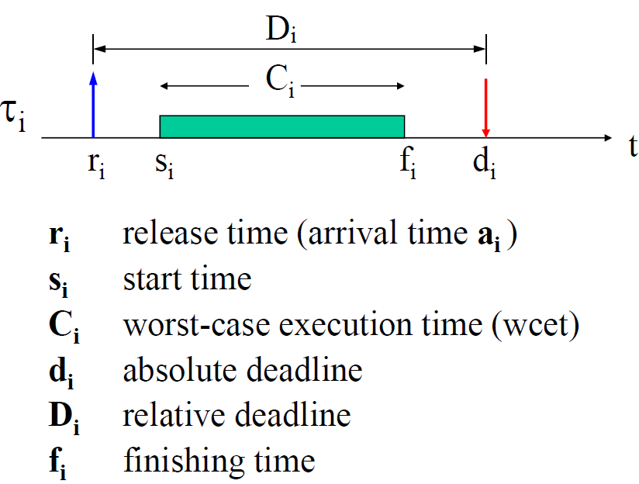
Periodic Task Params
Notes:
A schedule is said to be feasible, if all task can be completed according to a set of specified constraints.
A set of tasks is said to be schedulable, if there exists at least one algorithm that can produce a feasible schedule.
Arrival time or release time is the time at which a task becomes ready for execution.
Computation time is the time necessary to the processor for executing the task without interruption.
Deadline is the time at which a task should be completed.
Start time is the time at which a task starts its execution.
Finishing time is the time at which a task finishes its execution.

Slide 55
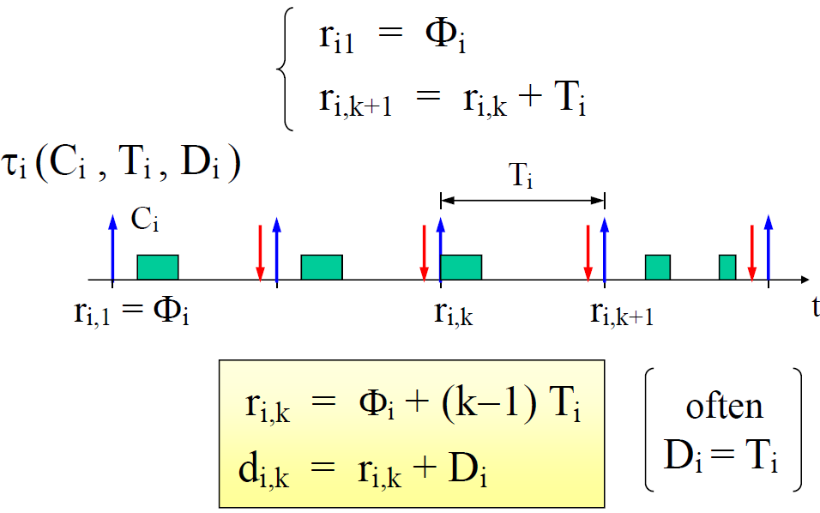
Periodic Task Model
Release Offset

Slide 56
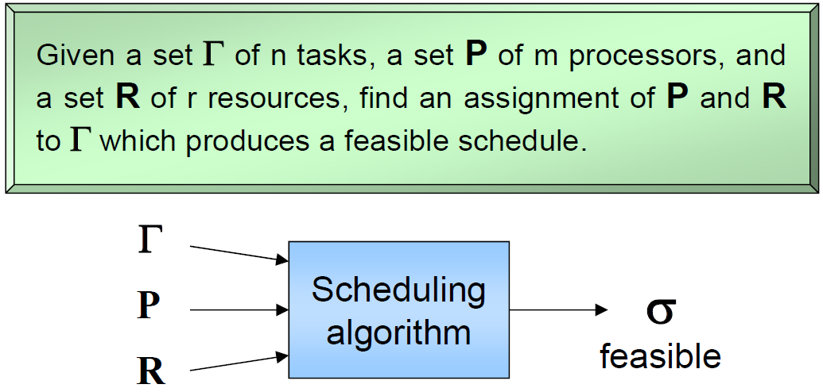
The General Scheduling Problem

Slide 57
Preemptive vs. Non-Preemptive
A scheduling algorithm is:
preemptive: if the active job can be temporarily suspended to execute a more important job.
non preemptive: if the active job cannot be suspended, i.e., always runs to completion.

Slide 58
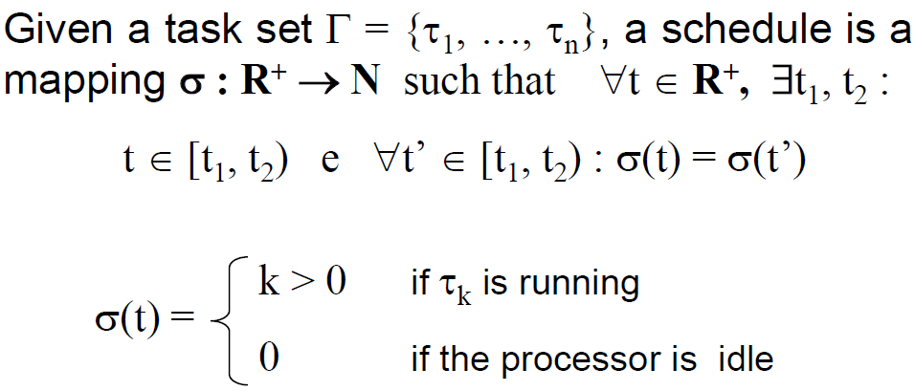
Schedule
When used as a noun, a schedule is an execution trace
When used as a verb, to schedule a taskset is to find a feasible schedule (noun)

Slide 59
Definitions
A schedule σ is feasible if all tasks meet their deadlines given a set of constraints
A taskset Γ is schedulable if there exists a feasible schedule for it

Slide 60
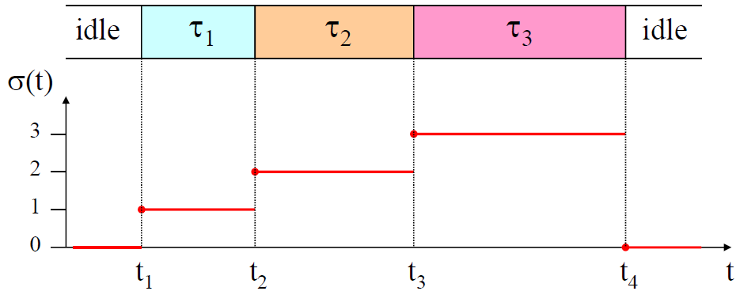
An Example Schedule
At time t₁, t₂, t₃, t₄, a context switch is performed

Slide 61
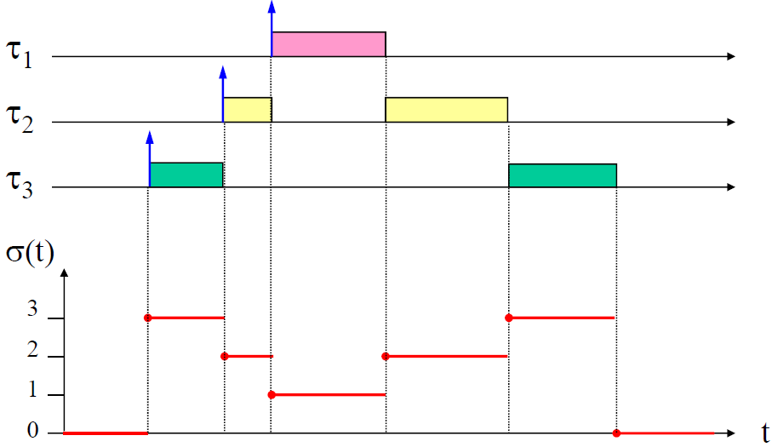
A Preemptive Schedule
Priority τ₁>τ₂>τ₃
Convention: higher-priority tasks are placed higher in the schedule chart

Slide 62
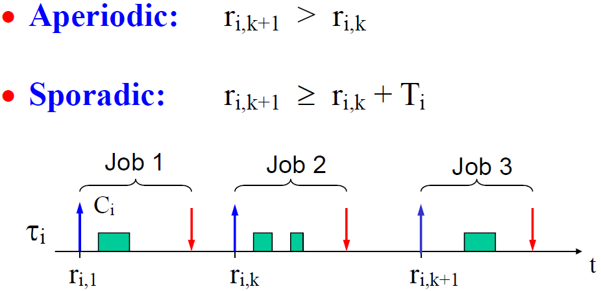
Aperiodic and Sporadic Task Model

Slide 63
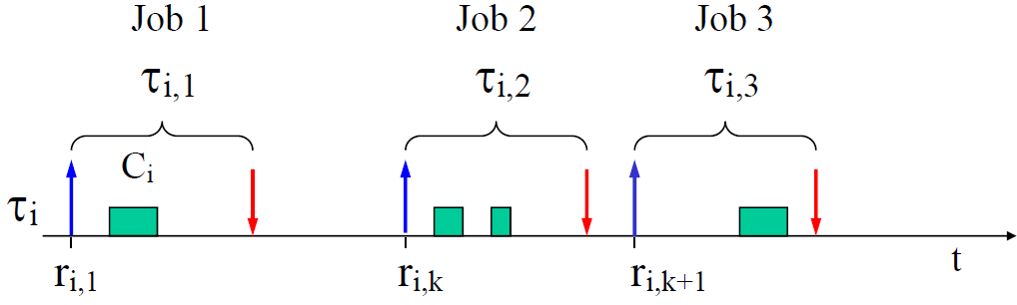
Definition: Task & Job
A task is an infinite sequence of jobs

Slide 64
Types of Tasks
Periodic task
Triggered at fixed periods by a timer
Aperiodic task
Triggered by external interrupts
Sporadic task
Triggered by external interrupts, but with minimum inter-arrival time (MIT) between interrupts
Can be treated as a periodic task with period equal to MIT
We typically assume periodic task model for schedulability analysis

Slide 65
Slack and Lateness
A task’s worst-case response time R_{i} =f_{i} - a_{i} is defined as the worst-case finish time minus its arrival time
It includes Worst-Case Execution Time (WCET) C_{i} plus possible delays caused by other concurrent tasks in the system
“Slack” if lateness is negative (task completes before deadline)
“Tardiness” or “exceeding time” E_{i} = max(0, L_{i})
D_{i}
τ_{i}
a_{i}
s_{i}
f_{i}
d_{i}
t
R_{i}
C_{i}
D_{i}
lateness
L_{i} = f_{i} - d_{i}
τ_{i}
t
ªi ^{s}i
d_{i} f_{i}
t
a_{i} s_{i} f_{i}
R_{i}
Notes:
“Laxity” or “slack time” X_{i} = d_{i} – a_{i} – C_{i} slack_{i} = d_{i} - f_{i}

Slide 66
How to prevent a user-level thread from hogging the CPU?
Strategy 1: force everyone to cooperate
a thread willingly gives up the CPU by calling yield()
yield() calls into the scheduler, which context switches to another ready thread
what happens if a thread never calls yield()?
Strategy 2: use preemption
scheduler requests that a timer interrupt be delivered by the OS periodically
usually delivered as a UNIX signal (man signal)
signals are just like software interrupts, but delivered to user-level by the OS instead of delivered to OS by hardware
at each timer interrupt, scheduler gains control and context switches as appropriate

Slide 67
Thread context switch
Very simple for user-level threads:
save context of currently running thread
push machine state onto thread stack
restore context of the next thread
pop machine state from next thread’s stack
return as the new thread
execution resumes at PC of next thread
This is all done by assembly language
it works at the level of the procedure calling convention
thus, it cannot be implemented using procedure calls
e.g., a thread might be preempted (and then resumed) in the middle of a procedure call

Slide 68
What if a thread tries to do I/O?

Slide 69
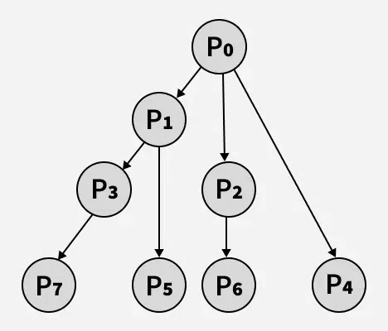
Fork Quiz
The number of times ‘hello’ is printed is equal to the total number of processes = 2^n, where n is the number of fork system calls. So here n = 3, 2^3 = 8.
Main process: P0
1 child process created by the 1st fork: P1
2 child processes created by the 2nd fork: P2, P3
4 child processes created by the 3rd fork: P4, P5, P6, P7
In general, for (i = 0; i < n; i++) fork();” creates 1+2+…+2^(n-1)=(2^n)-1 child processes. Plus the main process P0, we have a total of 2^n processes.
Order of process execution may vary depending on how OS schedules these processes, so you don’t know which process printed which hello.
None of the processes include a wait() call to handle terminated child processes. When any of these child processes terminate, their PCBs remain in the process table as no parent process is waiting on them, resulting in zombie processes. (This also applies to the following examples.)
Output:
hello
hello
hello
hello
hello
hello
hello
hello
Notes:
The number of times ‘hello’ is printed is equal to the number of processes created. Total Number of Processes = 2^{n}, where n is the number of fork system calls. So here n = 3, 2³ = 8 Let us put some label names for the three lines:’
Let us put some label names for the three lines:
fork (); // Line 1
fork (); // Line 2
fork (); // Line 3
L1 // 1 child process created by line 1.
/ \
L2 L2 // 2 child processes created by line 2.
/ \ / \
L3 L3 L3 L3 // 4 child processes created by line 3.

Slide 70
Typical Memory Hierarchy
On-Chip Components
Control
Instr
Cache
Second
Level
Cache
(SRAM)
Secondary
Memory
(Disk
Or Flash)
Main
Memory
(DRAM)
Datapath
RegFile
Data
Cache
Speed (cycles): ½’s 1’s 10’s 100’s 1,000,000’s
Size (bytes): 100’s 10K’s M’s G’s T’s
Cost/bit: highest lowest
70
Notes:
Instead, the memory system of a modern computer consists of a series of black boxes ranging from the fastest to the slowest.
Besides variation in speed, these boxes also varies in size (smallest to biggest) and cost.
What makes this kind of arrangement work is one of the most important principle in computer design. The principle of locality. The principle of locality states that programs access a relatively small portion of the address space at any instant of time.
The design goal is to present the user with as much memory as is available in the cheapest technology (points to the disk).
While by taking advantage of the principle of locality, we like to provide the user an average access speed that is very close to the speed that is offered by the fastest technology.
(We will go over this slide in detail in the next lectures on caches).

Slide 71

Memory Hierarchy

Slide 72
TLB Example This is wrong. A Page is 4KB and can contain 1K integers, not 4 integers.
In virtual memory space layout, array elements a[0] to a[2] are in the same memory page with VPN 06; a[3] to a[6] in the same memory page with VPN 07; a[7] to a[9] in the same memory page with VPN 08;
OFFSET 00 04 08 12 16
VPN = 00
VPN = 01
VPN = 03
VPN = 04
VPN = 05
VPN = 06 |  | a[0] | a[1] | a[2]
VPN = 07 | a[3] | a[4] | a[5] | a[6]
VPN = 08 | a[7] | a[8] | a[9]
VPN = 09
VPN = 10
VPN = 11
VPN = 12
VPN = 13
VPN = 14
VPN = 15
0: int sum = 0 ;
1: for( i=0; i<10; i++){
2: sum+=a[i];
3: }
3 misses for looking up physical memory addresses of a[0], a[3], and a[7]. 7 hits for looking up physical memory addresses of the other array elements a[0], a[3], and a[7]. Thus TLB hit rate is 70%.
TLB improves performance due to spatial locality of page table lookups.
Notes:
Another example to show

Slide 73
Table Lookaside Buffer (TLB)
Temporal Locality
An instruction or data item that has been recently accessed will likely be re-accessed soon in the future.
Spatial Locality
If a program accesses memory at address x, it will likely soon access memory near x.
1st access is page1.
2nd access is also page1.
Page 6
…
Page 1
Page 7
Page 2
Page 3
Page 4
Page 5
Page n
Virtual Memory
1st access is page1.
2nd access is nearby page1.
Page 1
Page 2
Page 3
Page 4
Page 5
…
Page n
Virtual Memory

Slide 74
Quiz IV
Consider 8-bit address space; a DM, write-back, write-allocate cache that can hold two blocks of 8 Bytes each. The cache is initially empty. The following sequence of memory operations are made, where each reference is a byte address of a 4-byte number (Only consider word aligned word addresses, i.e. locations 0, 4, 8, and so on. lw: load word; sw: store word) :
lw 0
sw 44
lw 52
lw 88
lw 0
sw 52
lw 68
lw 44
Work out the cache behavior after each operation.
Notes:
Tag: 4 Index: 1 Offset: 3. The low-order 3 bits of an address specifies the byte address, and the next 1 bit is the index. I'll write addresses as a triple of tag:index:offset. We have:
lw 0 = 0000:0:000
Bytes 0-7 loaded into cache index 0.
sw 44= 0010:1:100
Bytes 40-47 loaded into cache index 1; bytes 44-47 modified; block marked "dirty".
lw 52 = 0011:0:100
Bytes 48-55 loaded into cache index 0; Clean miss (since replaced block was clean), previous block discarded
lw 88 = 0101:1:000
Bytes 88-95 loaded into cache index 1; Dirty miss (since replaced block was dirty); previous (dirty) contents written back to memory; block marked "clean“
lw 0 = 0000:0:000
Bytes 0-7 loaded into cache index 0. Clean miss; block marked “clean”
sw 52 = 0011:0:100
Bytes 48-55 loaded into cache index 0. Clean miss. bytes 52-55 modified; block marked "dirty".
lw 68 = 0010:0:100
Bytes 64-71 brought into cache index 0; Dirty miss; previous (dirty) contents written back to memory; block marked “clean”.
lw 44 = 0010:1:100
Bytes 40-47 loaded into cache index1; Clean miss; block marked "clean".

Slide 75


Livelock
Both processes use the polling primitive enter_region() to try to acquire locks via busy-waiting; process_A gets resource_1 and process_B gets resource_2.
Livelock, not deadlock, since no process is blocked.

Slide 76
Multi-Armed Lawyers
Consider a large table with IDENTICAL multi-armed alien lawyers. In the center is a pile of chopsticks. In order to eat, a lawyer must have one chopstick in each hand. The lawyers are so busy talking that they can only grab one chopstick at a time. Design a deadlock-free algorithm using monitors and Bankers algorithm. Assume total number of chopsticks >= number of hands of each lawyer, so at least one lawyer can eat.

Slide 77

GrabOne() allows a lawyer to grab one chopstick. It puts a lawyer to sleep if he cannot be granted a chopstick without potentially deadlocking the system.
ReleaseAll() allows a lawyer to release all chopsticks that he is holding. It wakes up any other lawyers that can proceed.
BankerCheck() method takes a Lawyer number, checks resources, and returns true if a given lawyer can be granted one new chopstick
Assume Mesa-style monitor, hence while loop is used in GrabOne().

Slide 78

BankerCheck() Method
State is safe if when a lawyer tries to take a chopstick, either
It is the last chopstick, but someone will have NumArms chopsticks afterwards
Or it is the 2nd to last chopstick, but someone will have NumArms-1 chopsticks afterwards
Or it is the 3rd to last chopstick, but someone will have NumArms-2 chopsticks afterwards …
Or…

Slide 79
Dining Lawyers Questions I
Q: Why didn’t we check for the case of NumChopsticks == 0?
A: In this case, (NumChopsticks-1) == -1, hence the if statement would always fail – exactly what we would want to do when NumChopsticks == 0

Slide 80
Dining Lawyers Questions II
Q: Is it a generalization of the 2-armed Dining Philosophers problem?
A: Not exactly. Since the chopsticks are in a pile at center of the table, we should model them as a single resource with multiple instances, instead of multiple resources for the Dining Philosophers. Hence the R and C matrices have a single column.

Slide 81
Dining Lawyers Questions III
Q: In its general form, the Banker’s algorithm makes multiple passes through the set of resource takers, finishing one at a time until all resource takers have finished. Explain why this particular application allows the BankerCheck method to implement the Banker’s algorithm by taking a single pass (until any one lawyer can get NumArms chopsticks).
A: Since every Lawyer has the same maximum allocation, and all chopsticks are equivalent. As a result, if we can find a single Lawyer that can finish, given the remaining resources, we know that all Lawyers can finish.
Reason: once that Lawyer finishes and returns their resources we know that there will be at least NumArms chopsticks on the table – hence everyone else can potentially finish. Thus, we don’t have to go through the exercise of returning resources and reexamining the remaining Lawyers (as in the general specification of the Banker’s algorithm).

Slide 82
Dining Lawyers Variation I
Q: If each lawyer has 2 arms, and there is a pile of knives and forks at center of the table. Assume there are at least 1 knife and 1 fork, so at least one lawyer can eat. (There is no other constraint on the numbers of knives, forks, or lawyers.) Each lawyer follows the following steps:
(1) Pick up a knife
(2) Pick up a fork
(3) Eat
(4) Return the knife and fork to the pile
Can the system be deadlocked?
A: No, since it’s not possible to have circular waiting.

Slide 83
Dining Lawyers Variation II
Q: If each lawyer has 4 arms, and there is a pile of knives and forks at center of the table. Assume there are at least 2 knives and 2 forks, so at least one lawyer can eat. Each lawyer follows the following steps:
(1) Pick up 2 knives atomically
(2) Pick up 2 forks atomically
(3) Eat
(4) Return the knives and forks to the pile
Can the system be deadlocked?
A: No, since it’s not possible to have circular waiting.

Slide 84
Dining Lawyers Variation III
Q: If each lawyer has 4 arms, and there is a pile of knives and forks at center of the table. Assume there are at least 2 knives and 2 forks, so at least one lawyer can eat. Each lawyer follows the following steps:
(1) Pick up a knife
(2) Pick up another knife
(3) Pick up a fork
(4) Pick up another fork
(5) Eat
(6) Return the knife and fork to the pile
Can the system be deadlocked?
A: Yes, since requests for each resource type (knife or fork) are not granted atomically. Need Banker’s algorithm to detect (potential) deadlocks.
Consider 2 lawyers, and a total of 2 knives and 2 forks available. If each lawyer picks up a knife, the system is deadlocked.
Recall Slide 14 “Define a total order of resource types; If a process holds certain resources, it can subsequently request only resources that follow the types of held resources in the total order.” This means you cannot request a knife while holding a knife.

Slide 85
Dining Lawyers Variation III
Q: What if each lawyer sitting around the table may have a different number of arms, and may request a different ratio of knives vs. forks?
A: The solution is basically the same, except implementation of Banker’s algorithm needs to take into account this factor, e.g., have an array of variables NumArms[] instead of a single variable NumArms, and so on.

Slide 86
Measuring Cache Performance – Effect on CPI
Assuming cache hit costs are included as part of the normal CPU execution cycle, then
CPU time = IC (Instruction Count) × CPI (Cycles per Instruction)× CC (Clock Cycle)
= IC × (CPI_{ideal} + Average Memory-stall cycles) × CC
CPI_{stall}
A simple model for Memory-stall cycles
Memory-stall cycles = accesses/instruction × miss rate × miss penalty
Notes:
Reasonable write buffer depth (e.g., four or more words) and a memory capable of accepting writes at a rate that significantly exceeds the average write frequency means write buffer stalls are small

Slide 87
Impacts of Cache Performance
Relative $ penalty increases as processor performance improves (faster clock rate and/or lower CPI)
Memory speed unlikely to improve as fast as processor cycle time. When calculating CPI_{stall}, cache miss penalty is measured in processor clock cycles needed to handle a miss
Lower the CPI_{ideal}, more pronounced impact of stalls
Processor with a CPI_{ideal} of 2, a 100 cycle miss penalty, 36% load/store instr’s, and 2% I$ and 4% D$ miss rates
Memory-stall cycles = 2% × 100 + 36% × 4% × 100 = 3.44
So CPI_{stalls} = 2 + 3.44 = 5.44
More than twice CPI_{ideal}!
Notes:
What if the CPI_{ideal} is reduced to 1?
What if the D$ miss rate went up by 1%?
For ideal CPI = 1, then CPIstall = 4.44 and the amount of execution time spent on memory stalls would have risen from 3.44/5.44 = 63% to 3.44/4.44 = 77%
For miss penalty of 200, memory stall cycles = 2% 200 + 36% x 4% x 200 = 6.88 so that CPIstall = 8.88
This assumes that hit time (so hit time is 1 cycle) is not a factor in determining cache performance. A larger cache would have a longer access time (if a lower miss rate), meaning either a slower clock cycle or more stages in the pipeline for memory access.

Slide 89
Thought Experiment: Tag-in-the-Middle
What if we flip positions of Tag and Index, and have Index as higher-order bits, and Tag as lower-order bits, i.e., Set Index-Tag-Offset instead of the usual Tag-Set Index-Offset model?
Consider the previous example with the Set Index-Tag-Offset model.

Slide 90
DM Cache w/ Tag-in-the-Middle
Main Memory
0000xx
0001xx
0010xx
0011xx
0100xx
0101xx
0110xx
0111xx
1000xx
1001xx
1010xx
1011xx
1100xx
1101xx
1110xx
1111xx
Neighboring blocks in memory are mapped to the same cache line, since they share the same Set Index value
If memory blocks are accessed sequentially, then each new incoming cache block will immediately replace the previous block at the same cache line, causing cache thrashing → cannot exploit spatial locality.
Bad idea!
Cache
Way
Set
Valid
Tag
Data
0
1
0
2
3
6-bit memory address: 2-bit Set Index, 2-bit Tag, 2-bit Offset (4 Bytes/block).
5
4
3
2
1
0
Set Index | Tag | Offset

Slide 91
Example: DM Cache w/ Set Index-Tag-Offset
0
1
1
For Set Index-Tag-Offset model: 10000 misses
1st cache miss brings a block with address 0000xx into cache Set 0, which contains A[0]
2nd cache miss brings a block with address 0001xx into cache Set 0, which contains A[1], and replaces A[0]
3rd cache miss brings a block with address 0010xx into cache Set 0, which contains A[2], and replaces A[1]
4th cache miss brings a block with address 0011xx into cache Set 0, which contains A[3], and replaces A[2]
All subsequent cache accesses are cache misses
After 10000 iterations, 10000 cache misses, 0 cache hits.
Main Memory
A[0]
0000xx
0001xx
0010xx
0011xx
0100xx
0101xx
0110xx
0111xx
1000xx
1001xx
1010xx
1011xx
1100xx
1101xx
1110xx
1111xx
Cache
A[1]
A[2]
Way
Set
Valid
Tag
Data
A[3]
0
01
10
A[1]
1
00
A[2]
11
A[0]
A[3]
1
0
2
3
5
4
3
2
1
0
Set Index | Tag | Offset
Notes:
5th cache miss brings a block with address 0000xx into cache Set 0, which contains A[0], and replaces A[3]

Slide 92
2-Way SA Cache w/ Tag-in-the-Middle
Main Memory
0000xx
0001xx
0010xx
0011xx
0100xx
0101xx
0110xx
0111xx
1000xx
1001xx
1010xx
1011xx
1100xx
1101xx
1110xx
1111xx
Still a likely bad idea, but not as bad as the DM cache in the last slide
Each set (color) has 2 possible addresses in the cache
As associativity increases, the Set Index-Tag-Offset model becomes more feasible
Cache
Way
Set
Valid
Tag
Data
0
0
1
1
0
1
6-bit memory address: 3-bit Tag, 1-bit Set Index, 2-bit Offset (each cache block is 4 Bytes/1 Word).
5
4
3
2
1
0
Index | Tag | Offset
Notes:
For lecture
Valid bit indicates whether an entry contains valid information – if the bit is not set, there cannot be a match for this block One word blocks
Two low order bits (xx) define the byte in the block (1 word = 4 Byes) (i.e., modulo the number of blocks in the cache)

Slide 93
Example: 2-Way SA Cache w/ Set Index-Tag-Offset
Main Memory
For Set Index-Tag-Offset model: 10000 misses with LRU (Least-Recently-Used) replacement policy
1st cache miss brings into cache a block with address 0000xx into Set 0, which contains A[0]
2nd cache miss brings into cache a block with address 0001xx into Set 0, which contains A[1]
3rd cache miss brings into cache a block with address 0010xx into Set 0, which contains A[2], and replaces A[0]
4th cache miss brings into cache a block with address 0011xx into Set 0, which contains A[3], and replaces A[1]
All subsequent cache accesses are cache misses.
After 10000 iterations, 10000 cache misses
A[0]
0000xx
0001xx
0010xx
0011xx
0100xx
0101xx
0110xx
0111xx
1000xx
1001xx
1010xx
1011xx
1100xx
1101xx
1110xx
1111xx
Cache
A[1]
A[2]
Way
Set
Valid
Tag
Data
A[3]
0
1
000
010
A[2]
A[0]
0
1
1
011
A[1]
1
0
001
A[3]
1
5
4
3
2
1
0
Index | Tag | Offset
Notes:
(MRU (Most-Recently-Used) replacement policy can keep A[0] and A[2] in cache, leading to lower Miss rate. Details omitted)
5th cache miss brings into cache a block with address 0000xx into Set 0, and replaces A[2].

Slide 94
FA Cache w/ Tag-in-the-Middle
Main Memory
0000xx
0001xx
0010xx
0011xx
0100xx
0101xx
0110xx
0111xx
1000xx
1001xx
1010xx
1011xx
1100xx
1101xx
1110xx
1111xx
For FA cache, there is no Set Index, so Set Index-Tag-Offset model is the same as Tag-Set Index-Offset model
4 misses with LRU (Least-Recently-Used) replacement policy
Cache
Way
Set
Valid
Tag
Data
0
1
0
2
3
6-bit memory address: 3-bit Tag, 1-bit Set Index, 2-bit Offset (each cache block is 4 Bytes/1 Word).
5
4
3
2
1
0
Tag | Offset
Notes:
For lecture
Valid bit indicates whether an entry contains valid information – if the bit is not set, there cannot be a match for this block One word blocks
Two low order bits (xx) define the byte in the block (1 word = 4 Byes) (i.e., modulo the number of blocks in the cache)
Trick question! There is no Set Index, so the two models are the same!

Slide 95
Insight
Tag-Set Index-Offset model has better spatial locality than Set Index-Tag-Offset model, hence it is chosen for actual cache design

Slide 96
Answer: # Cache Misses for DM Cache
Review
Consider the following program that repeatedly accesses an array of words A[4]
for (int i=0; i++, i<10000) {sum += A[0]+A[1]+A[2]+A[3];}
Suppose A[0] starts at memory address 000000, how many cache misses due to reading array A[] for a DM cache with either 1) the Tag-Set Index-Offset model; or 2) the Set Index-Tag-Offset model? How to classify the cache misses?
For Tag-Set Index-Offset model: 4 misses
1st cache miss brings into cache a block with address 0000xx into Set 0, which contains A[0]
2nd cache miss brings into cache a block with address 0001xx into Set 1, which contains A[1]
3rd cache miss brings into cache a block with address 0010xx into Set 2, which contains A[2]
4th cache miss brings into cache a block with address 0011xx into Set 3, which contains A[3]
9996 cache hits.
For Set Index-Tag-Offset model: 10000 misses
1st cache miss brings into cache a block with address 0000xx into Set 0, which contains A[0]
2nd cache miss brings into cache a block with address 0001xx into Set 0, which contains A[1], and replaces A[0]
3rd cache miss brings into cache a block with address 0010xx into Set 0, which contains A[2], and replaces A[1]
4th cache miss brings into cache a block with address 0011xx into Set 0, which contains A[3], and replaces A[2]
5th cache miss brings into cache a block with address 0000xx into Set 0, which contains A[0], and replaces A[3]
…
4 misses are all compulsory
4 misses are compulsory
9996 misses are conflict
Notes:
4 cache misses:

Slide 97
Answer: # Cache Misses for 2-Way SA Cache
Review
Consider the following program that repeatedly accesses an array of words A[4]
for (int i=0; i++, i<10000) {sum += A[0]+A[1]+A[2]+A[3];}
Suppose A[0] starts at memory address 000000, how many cache misses due to reading array A[] for a 2-way SA cache with either 1) the Tag-Set Index-Offset model; or 2) the Set Index-Tag-Offset model? How to classify the cache misses?
For Tag-Set Index-Offset model: 4 misses
1st cache miss brings into cache a block with address 0000xx into Set 0, which contains A[0]
2nd cache miss brings into cache a block with address 0001xx into Set 1, which contains A[1]
3rd cache miss brings into cache a block with address 0010xx into Set 0, which contains A[2]
4th cache miss brings into cache a block with address 0011xx into Set 1, which contains A[3]
9996 cache hits.
For Set Index-Tag-Offset model: 10000 misses
1st cache miss brings into cache a block with address 0000xx into Set 0, which contains A[0]
2nd cache miss brings into cache a block with address 0001xx into Set 0, which contains A[1]
3rd cache miss brings into cache a block with address 0010xx into Set 0, which contains A[2], and replaces one of A[0] or A[1]. Suppose A[0] is replaced.
4th cache miss brings into cache a block with address 0011xx into Set 0, which contains A[3], and replaces one of A[1] or A[2]. Suppose A[1] is replaced
5th cache miss brings into cache a block with address 0000xx into Set 0, and replaces one of A[2] or A[3]
…
4 misses are all compulsory
4 misses are compulsory
9996 misses are conflict
Notes:
4 cache misses:

Slide 98
Answer: # Cache Misses for FA Cache
Review
Consider the following program that repeatedly accesses an array of words A[4]
for (int i=0; i++, i<10000) {sum += A[0]+A[1]+A[2]+A[3];}
Suppose A[0] starts at memory address 000000, how many cache misses due to reading array A[] for a FA cache with either 1) the Tag-Set Index-Offset model; or 2) the Set Index-Tag-Offset model? How to classify the cache misses?
For either model: 4 misses
1st cache miss brings into cache a block with address 0000xx into Set 0, which contains A[0]
2nd cache miss brings into cache a block with address 0001xx into Set 0, which contains A[1]
3rd cache miss brings into cache a block with address 0010xx into Set 0, which contains A[2]
4th cache miss brings into cache a block with address 0011xx into Set 0, which contains A[3]
9996 cache hits.
4 misses are compulsory
Notes:
4 cache misses:

Slide 99
Memory Hierarchy Speed vs. Size
On-Chip Components
CPU Control
Instr
Cache
Second
Level
Cache
(SRAM)
Secondary
Memory
(Disk
Or Flash)
Main
Memory
(DRAM)
CPU
Datapath
RegFile
Data
Cache
Speed (cycles): ½’s 1’s 10’s 100’s 1,000,000’s
Size (bytes): 100B’s 10KB’s MB’s GB’s TB’s
Cost/bit: highest lowest
Notes:
Instead, the memory system of a modern computer consists of a series of black boxes ranging from the fastest to the slowest.
Besides variation in speed, these boxes also varies in size (smallest to biggest) and cost.
What makes this kind of arrangement work is one of the most important principle in computer design. The principle of locality. The principle of locality states that programs access a relatively small portion of the address space at any instant of time.
The design goal is to present the user with as much memory as is available in the cheapest technology (points to the disk).
While by taking advantage of the principle of locality, we like to provide the user an average access speed that is very close to the speed that is offered by the fastest technology.
(We will go over this slide in detail in the next lectures on caches).
Programmer-invisible hardware mechanism gives illusion of speed of fastest memory with size of largest memory
Works even if you have no idea what a cache is
Performance-oriented programmers sometimes “reverse engineer” cache organization to design data structures and access patterns optimized for a specific cache design

